Slide 1



A Book about Me
My name is:_____________
My Birthday is:__________

Slide 2

This is where I live:

Slide 3

The people who live in my home are:

Slide 4
Other people in my family

Slide 5

These people are important to me
These are my pets

Slide 6


My friends are called:
something special

Slide 7
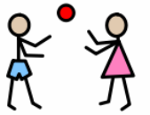
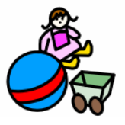
I like to play with:
Activities I enjoy:

Slide 8


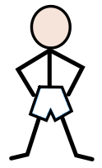

food I like
food I don’t like
Things I can do by myself:
Things I need help with:

Slide 9



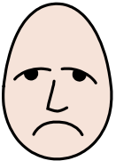
The language I speak at home is:
How do I communicate e.g. special words I use.
Sometimes I feel cross or sad, the adults at home help me by:

Slide 10


I do/don’t have a sleep in the day.
My routine is:

