Slide 1
Welcome to starling class
Year 1 and Year 2

Slide 2


Slide 3
The school day
8.40am gates open and children can come onto the school site to go straight to their classroom
8.50am gates are locked, registers are taken
3.15pm gates are unlocked and parents can come onto site
3.20pm end of the school day
There is limited parking on St John’s Street, please park considerately, avoiding neighbours’ driveways.

Slide 4
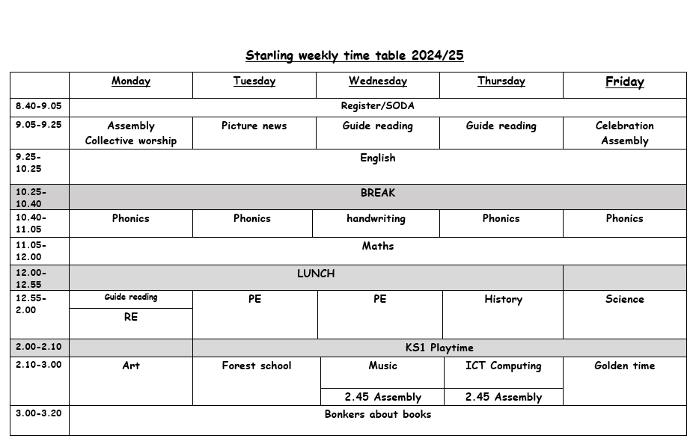

Slide 5
PE/Forest School
  Tuesday afternoon:
    Forest school
    PE
  Wednesday afternoon:
    PE

Slide 6
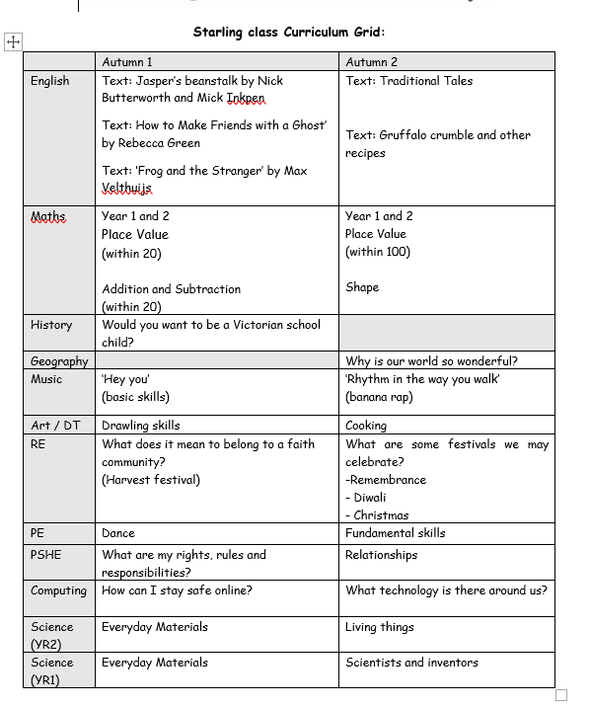

Slide 7
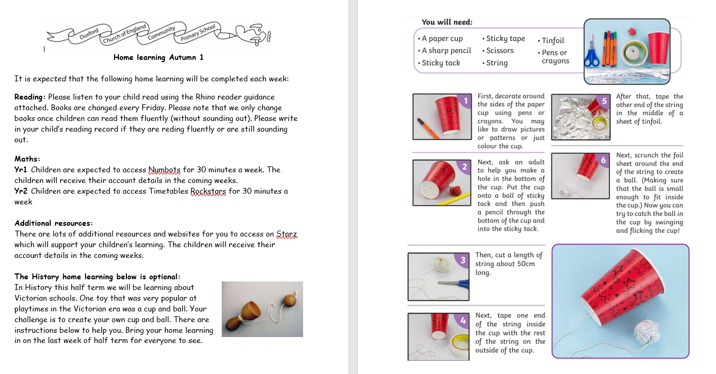

Slide 8
We set high expectations and encourage
Good behaviour - (Ready, Respect, Safe).
Following school ethos (AIMS).
Work ethic and independence.
Wearing correct uniform.

Slide 9
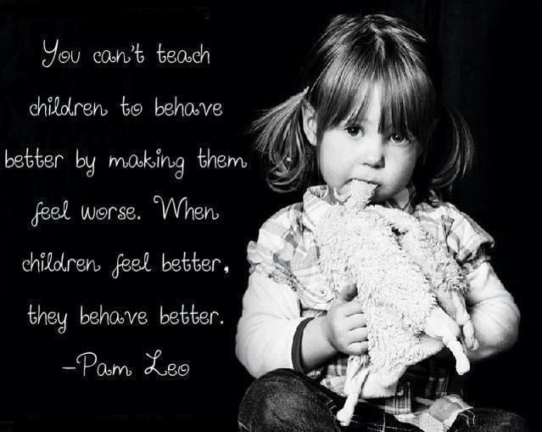
The Behaviour Curriculum
Behaviour is an element of the curriculum that is taught throughout the year.
We encourage all children to be ready, respectful and safe.
We use The Cambridgeshire Therapeutic Thinking Approach to underpin our behaviour policy.
We work hard to understand why children behave as they do then we support them to try and
improve their behaviour.

Slide 10

The Behaviour curriculum
We use the model of equity to try and give the children what they need in order to overcome barriers to making progress with their behaviour or learning.
There are always consequences for
detrimental behaviours. These will not
necessarily be shared with the whole class.

Slide 11
AIMS and Golden Rules
We focus on how we learn and good learning behaviours.
Our Golden rules in school are to be – Ready, Respectful, Safe.
Our AIMS in school are to be:
Attentive – value ourselves, the environment and each other.
Imaginative – broad curriculum, creative, problem solving, memorable
Motivated – trying our best, perseverance, growth mindset
Spiritual - wellbeing, friendship, being safe, Christian ethos

Slide 12
School Uniform
Please refer to the parent handbook.
Name everything!
Long hair must be tied back using plain hair accessories.
No nail varnish.
PE Uniform
On PE days, children should come to school in PE uniform.
Children should wear the school logo PE T-shirt or plain white T-shirt with jogging bottoms or shorts and trainers. Children should wear their school sweatshirt on PE days- other hoodies/ jumpers are not permitted.
Forest school
Clothing required – long sleeves and long trousers/leggings. A change of shoes – named wellies are ideal.
Children take part in den building, tree climbing, etc so must have their arms and legs covered as they are working in a natural environment.

Slide 13
Safeguarding
The law requires all school staff to pass on information which gives rise to a concern about a child’s welfare, including risk from neglect, physical, emotional or sexual abuse. Records of safeguarding concerns may be kept about their child. School staff will seek, in general, to discuss any concerns with you including referrals to other agencies.
If you need help with parenting (it’s a rewarding but tough job!) or you have concerns about your child’s behaviour or state of mind, do let us know and we will do all we can to help.

Slide 14

Online safety:
Online safety is a key part of safeguarding and protecting our children. Our staff have yearly online safety training to ensure we can protect the children in school. We have a firewall system in place which blocks inappropriate content and alerts SLT when inappropriate searches have been made.
Online safety at home is the responsibility of parents and carers. It is important to understand the sites and apps your children are accessing and the potential dangers of them. Children using apps while underaged is classed as a safeguarding concern in schools. There are many settings you can access within your WIFI network or the device itself to limit the content your children can see. We know that many children have smart phones and tablets now and encourage parents to be aware of what they are accessing on their devices.
If you would like more information, please access our school website or contact our online safety lead, Mrs Shevki.

Slide 15
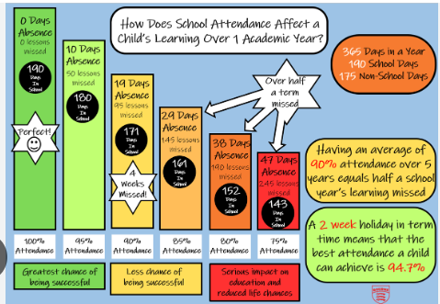
Attendance
The Department of Education has issued a new statutory guidance for attendance ‘Working Together to Improve School Attendance.’
Schools are now legally obliged to support and work together with families where attendance is below 90%.
Term Time Leave- the fines for a penalty notice are increasing to £80 per parent per child. For second offences within a three-year rolling period, the fine is a flat £160 per parent per child.
The attendance policy has been updated to reflect these national changes. For the full information, please refer the policy which will be found on the school website.

Slide 16
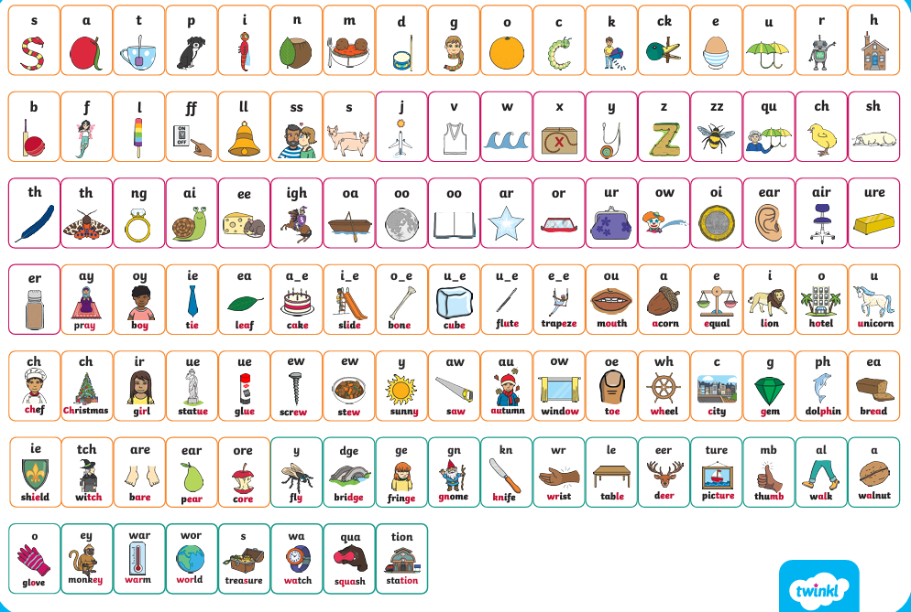
Phonics and reading:
Reading is taught via daily Phonics lessons using the Twinkl phonics programme, which is a government accredited scheme, running from Reception to Year 2.
Phonics is taught in progressive levels:
Reception- Level 1,2,3,4
Year 1- Level 5
Year 2- Level 6 (spelling focus)
We use ‘Rhino reading’ books which match the Twinkl phonics scheme. This means that the children will never come home with a book containing sounds they haven’t been taught. The children’s books are changed every Friday but they can only be changed once the children can read their book fluently (without sounding out). If your child is still sounding out, they will keep their book for another week.
More guidance and information can be found on the school website.

Slide 17
End of the day routines
School ends at 3.20pm- please make sure your child know their end of day routine.
It is parents’ responsibility to inform the office of changes to routines.
Changes to bus routine- school must be informed. If we have to contact you, it delays the bus leaving. The bus company will not wait later than its designated time.
For safety, we will keep children in school if bus arrangements are unclear so that the other children can leave on time.
Children must be collected from the bus stops by an adult. If an adult is not there, the bus company will return the child to school.
Children in Year 5/Year 6 may walk home from school or the bus stop alone so long as school have written permission- please contact Mrs Rigby.

Slide 18
Admin
Please ensure that you inform the office:
If your contact details change.
If there are changes to going home routines (keep an eye out for start and end dates of after school clubs).
Any changes or events at home, such as a parent going away for a few days, the death of a pet etc. These can impact on how a child behaves at school.

Slide 19
Working together!
Talk to us!
Communication is vital.
Contact us via the school office office@duxford.cambs.sch.uk

