Slide 1
Welcome to our meet the teacher night

Slide 2
The school day
8.40am gates open and children can come onto the school site to go straight to their classroom
8.50am gates are locked, registers are taken
3.15pm gates are unlocked and parents can come onto site
3.20pm end of the school day
There is limited parking on St John’s Street, please park considerately, avoiding neighbours’ driveways.

Slide 3
Timetable:
 | SODA and register8:40- 8:55 | 9- 10:25 | 10:25- 10:40 Yr1- breaktime | 10:40- 11 | 11-12 | 12- 12:55 | 12:55- 2 | 2-3 | 3- 3:20
Mon |  | 9:05- y1 assembly R- phonics English | Y1- breaktime R- maths | Y1 phonics R- continuous provision | Y1 maths R- continuous provision | Lunch | Foundation subject eg. History, Geography, Music, Art, RE or PSHE | Foundation subject eg. History, Geography, Music, Art, RE or PSHE | Bonkers about books and get ready for home
Tues |  | English | Y1- breaktime R- maths | Y1 phonics R- continuous provision | Y1 maths R- continuous provision |  | Forest school | PE- cambs utd. | Bonkers about books and get ready for home
Weds |  | English | Y1- breaktime R- maths | R phonics R- continuous provision | Y1 maths R- continuous provision |  | Foundation subject eg. History, Geography, Music, Art, RE or PSHE | PE- Cambs utd. 2:45- y1 assembly | Bonkers about books and get ready for home
Thurs |  | English | Y1- breaktime R- maths | Y1 phonics R- continuous provision | Y1 maths R- continuous provision |  | Foundation subject eg. History, Geography, Music, Art, RE or PSHE | 2:45- y1 assembly/ R phonics | Bonkers about books and get ready for home
Fri |  | 9:05- y1 assembly R- phonics English | Y1- breaktime R- maths | Y1 phonics R- continuous provision | Y1 maths R- continuous provision |  | 1:10- 2 science R- continuous provision | 2:45- Buddy time | Bonkers about books and get ready for home

Slide 4
Home learning:
Reception:
Reading (books will be coming home by half term)
Y1:
Reading
Numbots
Optional home learning task

Slide 5
We set high expectations and encourage
Good behaviour - (Ready, Respect, Safe).
Following school ethos (AIMS).
Work ethic and independence.
Wearing correct uniform.

Slide 6
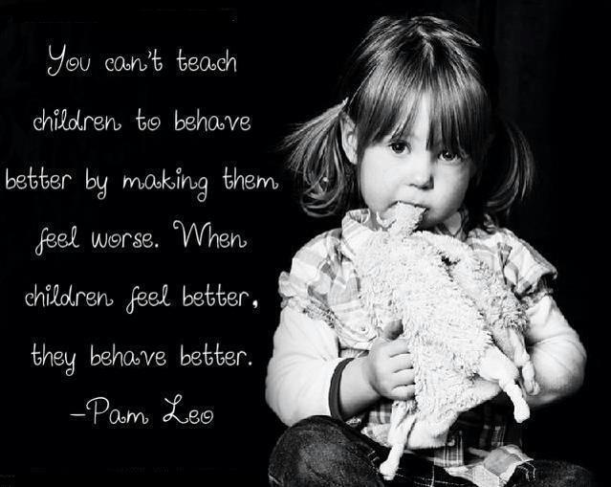
The Behaviour Curriculum
Behaviour is an element of the curriculum that is taught throughout the year.
We encourage all children to be ready, respectful and safe.
We use The Cambridgeshire Therapeutic Thinking Approach to underpin our behaviour policy.
We work hard to understand why children behave as they do then we support them to try and
improve their behaviour.

Slide 7
The Behaviour curriculum
We use the model of equity to try and give the children what they need in order to overcome barriers to making progress with their behaviour or learning.
There are always consequences for
detrimental behaviours. These will not
necessarily be shared with the whole class.

Slide 8
AIMS and Golden Rules
We focus on how we learn and good learning behaviours.
Our Golden rules in school are to be – Ready, Respectful, Safe.
Our AIMS in school are to be:
Attentive – value ourselves, the environment and each other.
Imaginative – broad curriculum, creative, problem solving, memorable
Motivated – trying our best, perseverance, growth mindset
Spiritual - wellbeing, friendship, being safe, Christian ethos

Slide 9
School Uniform
Please refer to the parent handbook.
Name everything!
Long hair must be tied back using plain hair accessories.
No nail varnish.
PE Uniform- Tuesday and Wednesday
On PE days, children should come to school in PE uniform.
Children should wear the school logo PE T-shirt or plain white T-shirt with jogging bottoms or shorts and trainers. Children should wear their school sweatshirt on PE days- other hoodies/ jumpers are not permitted.
Forest school- Tuesday
Clothing required – long sleeves and long trousers/leggings. A change of shoes – named wellies are ideal.
Children take part in den building, tree climbing, etc so must have their arms and legs covered as they are working in a natural environment.

Slide 10
Safeguarding
The law requires all school staff to pass on information which gives rise to a concern about a child’s welfare, including risk from neglect, physical, emotional or sexual abuse. Records of safeguarding concerns may be kept about their child. School staff will seek, in general, to discuss any concerns with you including referrals to other agencies.
If you need help with parenting (it’s a rewarding but tough job!) or you have concerns about your child’s behaviour or state of mind, do let us know and we will do all we can to help.

Slide 11
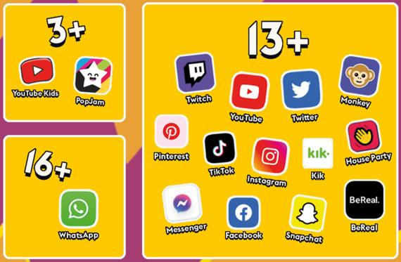
Online safety:
Online safety is a key part of safeguarding and protecting our children. Our staff have yearly online safety training to ensure we can protect the children in school. We have a firewall system in place which blocks inappropriate content and alerts SLT when inappropriate searches have been made.
Online safety at home is the responsibility of parents and carers. It is important to understand the sites and apps your children are accessing and the potential dangers of them. Children using apps while underaged is classed as a safeguarding concern in schools. There are many settings you can access within your WIFI network or the device itself to limit the content your children can see. We know that many children have phones and tablets now and encourage parents to be aware of what they are accessing on their devices.
If you would like more information, please access our school website or contact our online safety lead, Mrs Shevki.

Slide 12
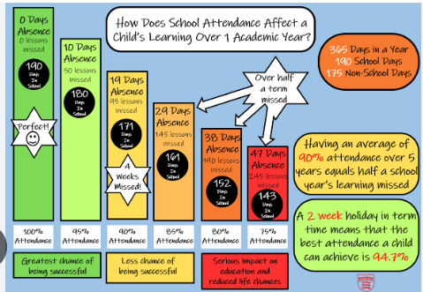
Attendance:
The Department of Education has issued a new statutory guidance for attendance ‘Working Together to Improve School Attendance.’
Schools are now legally obliged to support and work together with families where attendance is below 90%.
Term Time Leave- the fines for a penalty notice are increasing to £80 per parent per child. For second offences within a three-year rolling period, the fine is a flat £160 per parent per child.
The attendance policy has been updated to reflect these national changes. For the full information, please refer the policy which will be found on the school website.

Slide 13
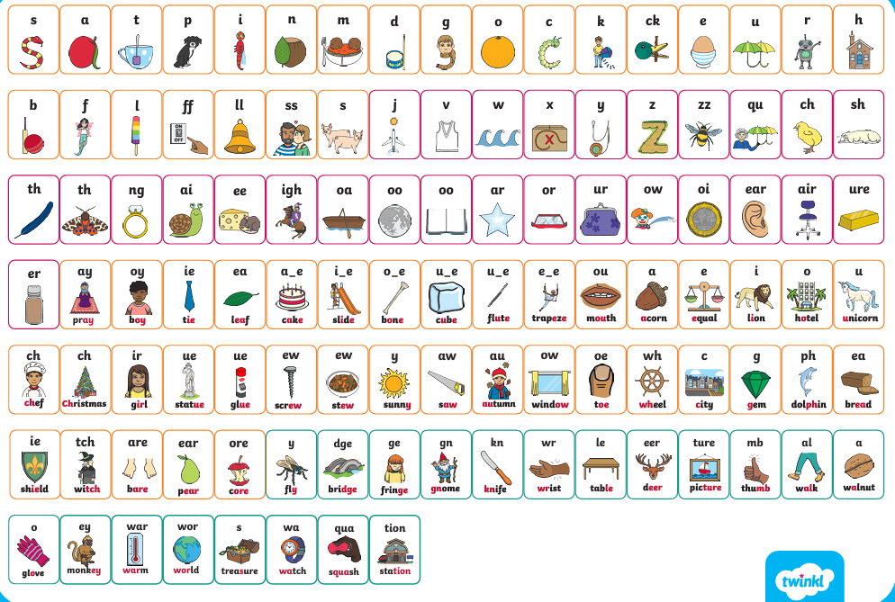
Phonics and reading:
Reading is taught via daily Phonics lessons using the Twinkl phonics programme, which is a government accredited scheme, running from Reception to Year 2.
Phonics is taught in progressive levels:
Reception- Level 1,2,3,4
Year 1- Level 5
Year 2- Level 6 (spelling focus)
We use ‘Rhino reading’ books which match the Twinkl phonics scheme. This means that the children will never come home with a book containing sounds they haven’t been taught. The children’s books are changed every Friday but they can only be changed once the children can read their book fluently (without sounding out). If your child is still sounding out, they will keep their book for another week.
More guidance and information can be found on the school website.

Slide 14
Next week the children will be taking part in the baseline assessment.
This is a series of activities designed to assess what the children know and what we need to focus on teaching them. The baseline results are compared to the children’s year 6 results when they leave school and act as a guide to see how much progress the pupils have made.
The baseline is done 1:1 with myself in a fun and engaging way. The baseline is not a test and isn’t something the children can prepare for.

Slide 15
End of the day routines:
School ends at 3.20pm- please make sure your child know their end of day routine.
It is parents’ responsibility to inform the office of changes to routines.
Changes to bus routine- school must be informed. If we have to contact you, it delays the bus leaving. The bus company will not wait later than its designated time.
For safety, we will keep children in school if bus arrangements are unclear so that the other children can leave on time.
Children must be collected from the bus stops by an adult. If an adult is not there, the bus company will return the child to school.
Children in Year 5/Year 6 may walk home from school or the bus stop alone so long as school have written permission- please contact Mrs Rigby.

Slide 16
Admin
Please ensure that you inform the office:
If your contact details change.
If there are changes to going home routines (keep an eye out for start and end dates of after school clubs).
Any changes or events at home, such as a parent going away for a few days, the death of a pet etc. These can impact on how a child behaves at school.

Slide 17
Working together!
Talk to us!
Communication is vital.
Contact us via the school office office@duxford.cambs.sch.uk

