Slide 1
Welcome to Y6 - Jays!

Slide 2
The school day
8.40am gates open and children can come onto the school site to go straight to their classroom
8.50am gates are locked, registers are taken
3.15pm gates are unlocked and parents can come onto site
3.20pm end of the school day
There is limited parking on St John’s Street, please park considerately, avoiding neighbours’ driveways.
Please remember that the bus bay is used for the school buses so avoid blocking it or parking in it.

Slide 3
Curriculum
Maths, English - These are taught daily. They may link with Topics but the basic skills are taught separately.
Guided reading is also taught daily and as a whole class.
Handwriting – a cursive style is used throughout the school. Year 6 children need to be joining their writing consistently.
SODA (Start of the Day Activity) - this is completed daily and is often used to practise skills taught in English and Maths.
SPAG – Children have separate spelling and grammar/punctuation lessons each week.

Slide 4
Foundation subjects
This year, topics have been designed by the Year 5/6 team, covering the appropriate learning objectives.
The variety of foundation subjects taught enable a broad & balanced curriculum to be provided.
History, D+T and Geography follow a topic-based approach. This term we will be looking at Japan, earthquakes and volcanoes.
Art now follows a spiral curriculum where the revisiting of units occurs throughout their time at primary school. Each year, the learning is deepened, with each successive encounter building on the previous one. Our current unit is printing.
Science, PSHE, French, computing & RE are taught independently.

Slide 5
Computing
Laptops & Ipads are used regularly in the classroom.
Carefully selected internet sites for children to use.
Internet safety is a priority at school as it should be at home.
E- safety taught explicitly.

Slide 6
Routines
PE – Tuesday and Wednesdays– come to school in kit, long hair tied up & no jewellery please.
Forest School is on a Tuesday.
Home Learning – this is now compulsory in Year 6. Every Friday the children will be given either a Maths or SPAG task to complete and return to school by Wednesday at the latest. This may include SATs style work.
Spellings & Times Tables (compulsory) – your child will receive a login for Spelling Shed and Times Tables Rockstars.
Children will bring home their spelling homework on a Thursday after our spelling lesson. This will usually be a rule that we have learnt in class which the children will need to learn and apply. The children may not always get a list of spelling words to learn but a task to find words that fit the rule.
Guided Reading home learning (compulsory) - set after a weekly session. Due in by Wednesday.
Please encourage time telling, money, measures, times tables rehearsal at home.

Slide 7
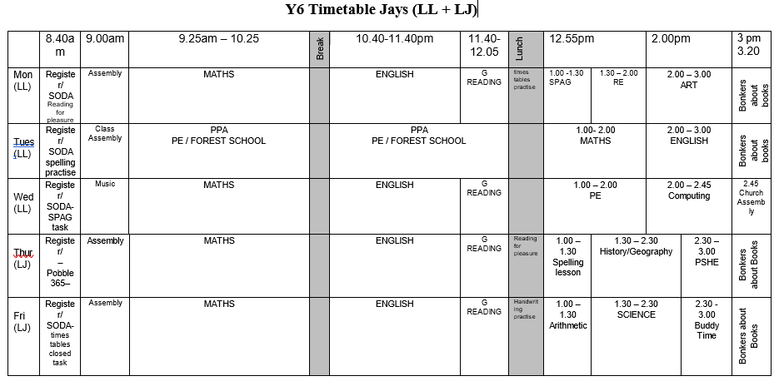
Example timetable

Slide 8
Assessment Y6
Assessment is ongoing.
This year the children will complete the KS2 SATs. (There will be a parent meeting nearer the time).
SATs will take place from Monday 12th May to Thursday 15th May.
They consist of…
Maths – 2 x reasoning papers, 1 x arithmetic paper
Reading Comprehension
Spelling, punctuation & grammar

Slide 9
Assessment Y6
Reporting arrangements. The new reporting arrangements come out in October.
Previously:
You would be given your child’s raw score (the actual number of marks they get), alongside their scaled score and whether they have reached the national average.
Children will be ‘working towards’, ‘ working at’ or ‘ working at greater depth’ within the expected standard.

Slide 10
Uniform
Name everything! Check regularly to make sure names are still visible.
Tie back long hair – this helps reduce the spread of nits.
No nail varnish please.

Slide 11
The Working Week.
Mrs Lawrence (Mon, Tues, Wed)
Mrs Johnston (Thurs, Fri)
PPA – Tuesday, covered by Sports Coach (PE) and Mrs Barnard (Forest School)
TA – Mrs Herring

Slide 12
Residential Trip
This year we are planning on taking the children to Norfolk Lakes for our 2 night residential trip.
Date – From Wednesday 11th June to Friday 13th July.
More information and letters to follow.

Slide 13
We set high expectations and encourage
Good behaviour - (Ready, Respect, Safe).
Work ethic
Independence
Wearing correct uniform
Following school ethos (AIMS).

Slide 14
AIMS and Golden Rules
We focus on how we learn and good learning behaviours.
Our Golden rules in school are to be – Ready, Respectful, Safe.
Our AIMS in school are to be:
Attentive – Value ourselves, the environment and each other.
Imaginative – Broad curriculum, creative, problem solving, memorable
Motivated – trying our best, perseverance, growth mindset
Spiritual - wellbeing, friendship, being safe, Christian ethos

Slide 15
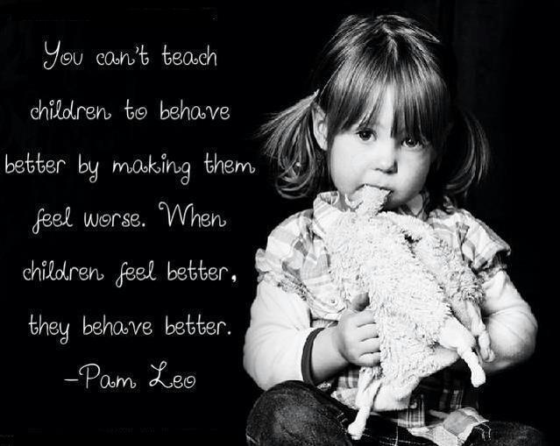
Behaviour
We encourage all children to be ready, respectful and safe.
We use Cambridgeshire STEPs to underpin our behaviour policy
This is a therapeutic approach and we work hard to understand why children behave as they do then we support them to improve their behaviour.
There are always consequences for
inappropriate behaviour.
Protective consequences manage the risk
of harm that results from dangerous
behaviours.
Educational consequences teach children
to understand how to behave.
Consequences are not broadcast to the class

Slide 16
Safeguarding
The law requires all school staff to pass on information which gives rise to a concern about a child’s welfare, including risk from neglect, physical, emotional or sexual abuse. Records of safeguarding concerns may be kept about their child. School staff will seek, in general, to discuss any concerns with you including referrals to other agencies.
If you need help with parenting (it’s a rewarding but tough job!) or you have concerns about your child’s behaviour or state of mind, do let us know and we will do all we can to help.

Slide 17
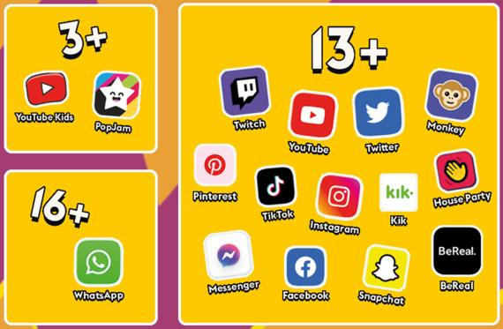
Online safety:
Online safety is a key part of safeguarding and protecting our children. Our staff have yearly online safety training to ensure we can protect the children in school. We have a firewall system in place which blocks inappropriate content and alerts SLT when inappropriate searches have been made.
Online safety at home is the responsibility of parents and carers. It is important to understand the sites and apps your children are accessing and the potential dangers of them. Children using apps while underaged is classed as a safeguarding concern in schools. There are many settings you can access within your WIFI network or the device itself to limit the content your children can see. We know that many children have smart phones and tablets now and encourage parents to be aware of what they are accessing on their devices.
If you would like more information, please access our school website or contact our online safety lead, Mrs Shevki.

Slide 18
Mental Wellbeing
The World Health Organisation definition of wellbeing is:
‘a state of mind in which an individual is able to realise his or her own abilities, cope with the normal stresses of life, can work productively and fruitfully, and is able to make a contribution to his or her community.’

Slide 19
What can we do to help?
Encourage your child with these 7 steps (SMILERS)to wellbeing:
Socialise-get together with others
Move-Be active
Interest-Have a hobby, keep learning, do something creative
Look-notice the world around you
Eat well-eat a balanced diet
Rest-relax, sleep well
Support-give help to others

Slide 20
End of the day
Please ensure your child knows their going home arrangements at the end of the day.
If they are allowed to walk home alone please inform the office.
Inform the office if there are changes to the usual routine.
Year 6 finish school at 3.20.

Slide 21
Bus
Bus – it is parents’ responsibility to inform the office of changes to routines.
If we have to contact you, it delays the bus leaving. The bus company will not wait later than its designated time.
For safety, we will keep children in school if bus arrangements are unclear so that the other children can leave on time.

Slide 22
Admin
Please ensure that you inform the office:
if your contact details change
if there are changes to going home routines (keep an eye out for start and end dates of after school clubs)
any changes or events at home, such as a parent going away for a few days, the death of a pet etc. These can impact on a child’s behaviour and learning at school.

Slide 23
Working together!
Talk to us!
Communication is vital.
Parents are not currently allowed in school without an appointment.
Contact us via the school office office@duxford.cambs.sch.uk

